Slide 1

Least Cost System Operation: Economic Dispatch 2
Smith College, EGR 325
March 10, 2006

Slide 2
Overview
Complex system time scale separation
Least cost system operation
  Economic dispatch first view
  Generator cost characteristics
System-level cost characterization
Constrained optimization
  Linear programming
  Economic dispatch completed

Slide 3
Time Scale Separation
Decide what to build
Given the plants that are built ⇨ decide which plants to have warmed up and ready to go this month, week...
Given the plants that are ready to generate ⇨ decide which plants to use to meet the expected load today, the next 5 minutes, next hour...
Given the plants that are generating ⇨ Decide how to maintain the supply and demand balance cycle to cycle

Slide 4
Economic Dispatch Recap
Economic dispatch determines the best way to minimize the current generator operating costs
Economic dispatch is not concerned with determining which units to turn on/off (this is the unit commitment problem)
Economic dispatch ignores the transmission system limitations

Slide 5
Constrained Optimization
& Economic Dispatch

Slide 6
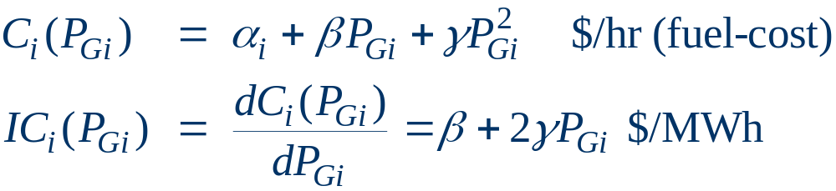
Mathematical Formulation of Costs
Generator cost curves are not actually smooth
Typically curves can be approximated using
  quadratic or cubic functions
  piecewise linear functions

Slide 7
Mathematical Formulation of Costs
The marginal cost is one of the most important quantities in operating a power system
Marginal cost = incremental cost: the cost of producing the next increment (the next MWh)
How do we find the marginal cost?

Slide 8
Economic Dispatch
An economic dispatch results in all the generator generating at a level where they have equal marginal costs (for a lossless system)
IC₁(P_{G,1}) = IC₂(P_{G,2}) = … = IC_{m}(P_{G,m})

Slide 9
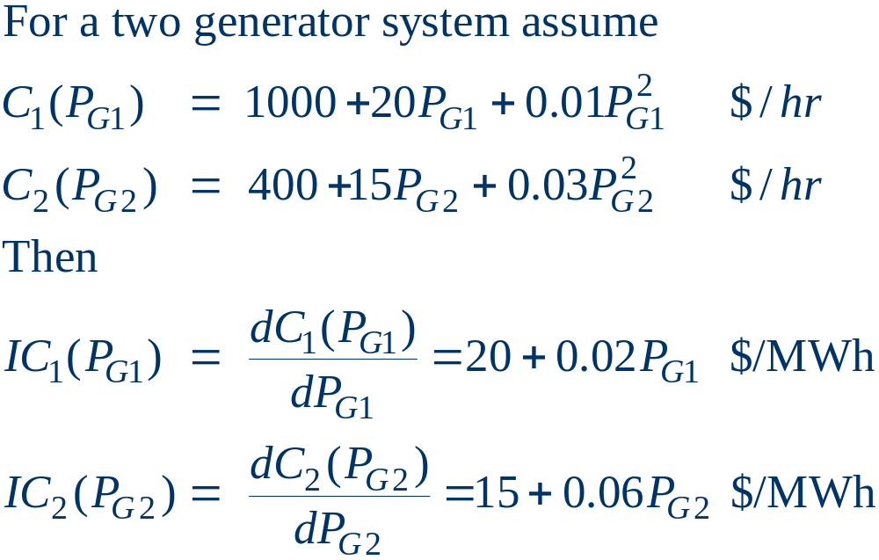
Incremental Cost Example

Slide 10
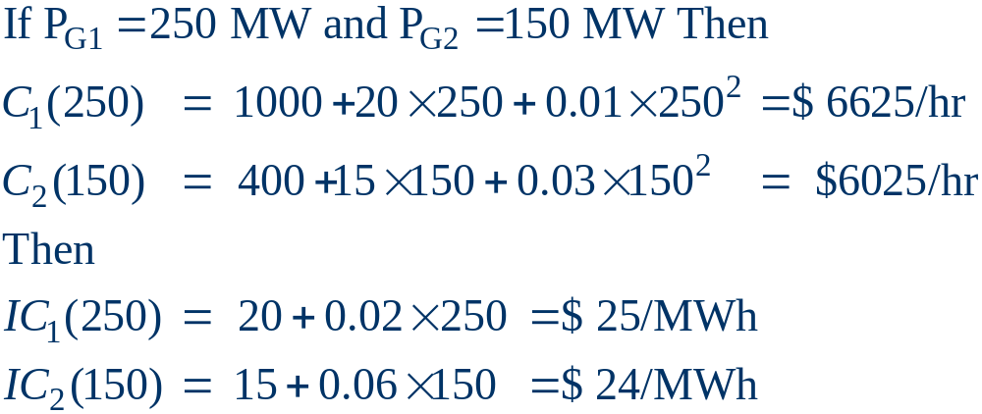
Incremental Cost Example

Slide 11
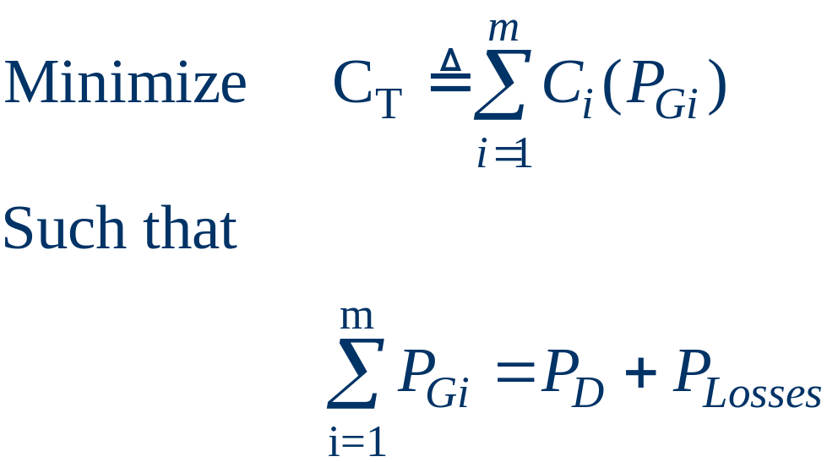
Economic Dispatch: Formulation
The goal of economic dispatch is to
  determine the generation dispatch that minimizes the instantaneous operating cost
  subject to the constraint that total generation = total load + losses
Initially we'll
ignore generator
limits and the
losses

Slide 12

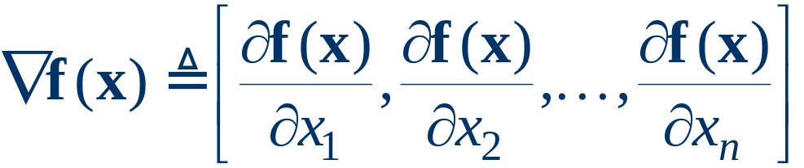
Unconstrained Minimization
This is a minimization problem with a single inequality constraint
For an unconstrained minimization a necessary (but not sufficient) condition for a minimum is the gradient of the function must be zero,
The gradient generalizes the first derivative for multi-variable problems:

Slide 13
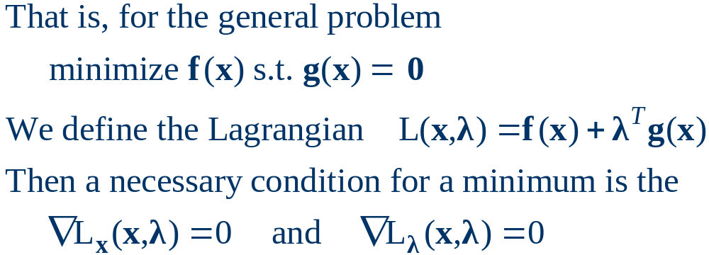
Minimization with Equality Constraint
When the minimization is constrained with an equality constraint we can solve the problem using the method of Lagrange Multipliers
Key idea is to modify a constrained minimization problem to be an unconstrained problem

Slide 14
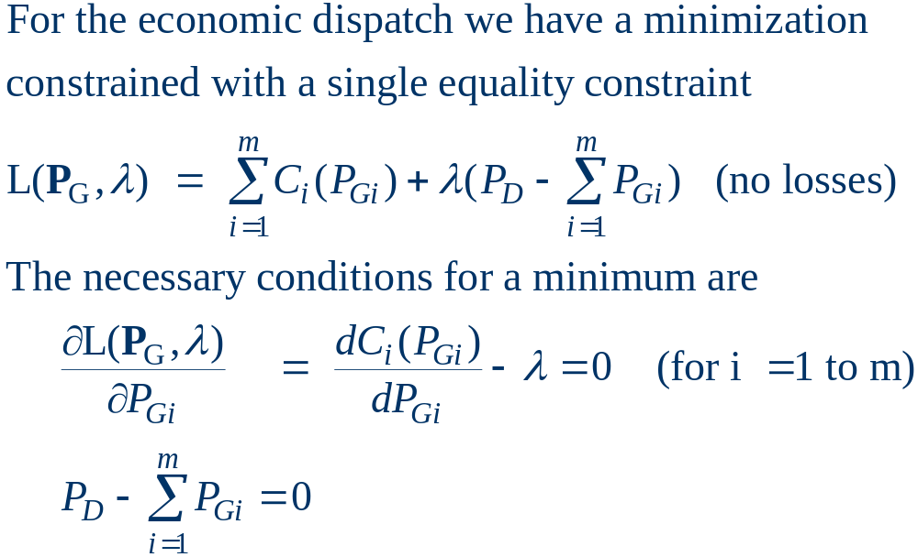
Economic Dispatch Lagrangian

Slide 15
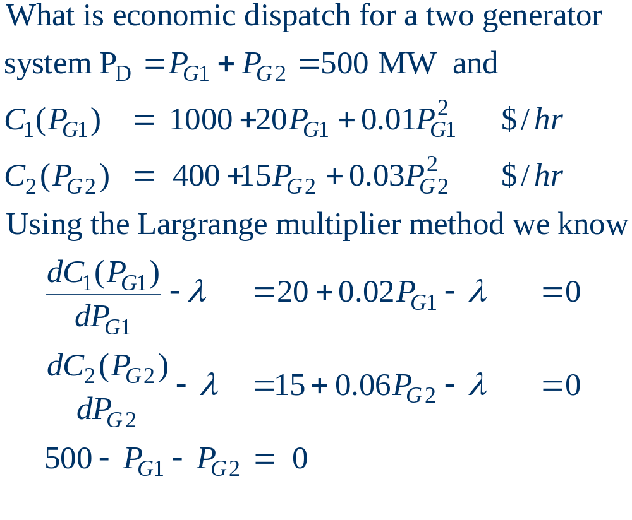
Economic Dispatch Example

Slide 16
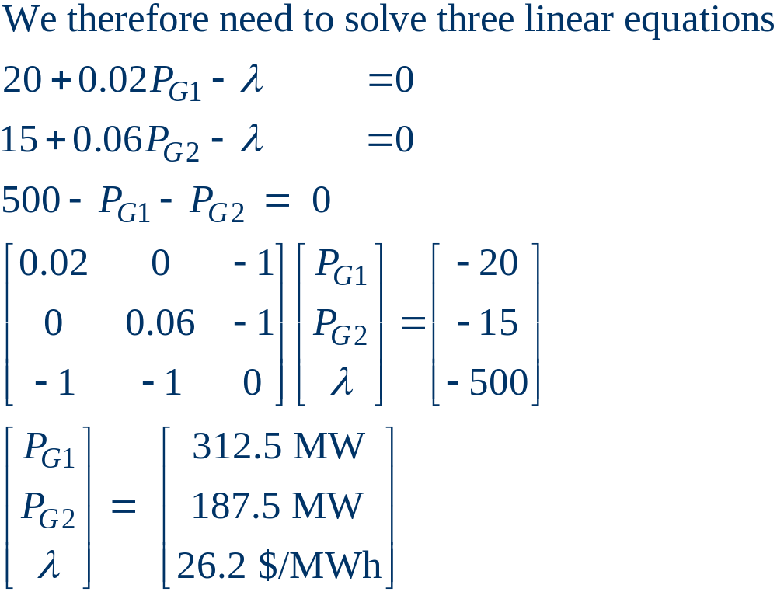
Economic Dispatch Example, cont’d

Slide 17
Constrained Optimization & Linear Programming

Slide 18
Linear Programming Definition
Optimization is used to find the “best” value
  “Best” defined by us, the analysts and designers
Constrained opt → Linear programming
  Linear constraints
  Complicates the problem
    Some binding, some non-binding
Visualize via a ‘feasible region’

Slide 19
Formulating the Problem
Objective function
Constraints
Decision variables
Variable bounds
Standard form
  min cx
  s.t. Ax = b
    x_{min} <= x <= x_{max}

Slide 20
Formulating the Problem
For power systems:
min C_{T} = ΣC_{i}(P_{Gi})
s.t. Σ(P_{Gi}) = P_{L}
P_{Gi min} <= P_{Gi} <= P_{Gi max}

Slide 21
Constrained Optimization
& Economic Dispatch
➔The Lagrangean

Slide 22
Formulating the Lagrangean
Rewrite the constrained optimization problem as an unconstrained optimization problem !
  Then we can use the simple derivative (unconstrained optimization) to solve
The task is to interpret the results correctly

Slide 23
Formulating the Lagrangean
We are minimizing gradients of both multivariate equations
  C_{T} & ΣP_{Gi} = P_{L}
For both equations to be at a minimum these gradients must be linearly dependent vectors
    ∇CT – λ∇w = 0
    with w ≡ ΣP_{G} – P_{L} = 0
The “Lagrangean multiplier”
  λ is defined to be the scaling variable that brings ∇C_{T} and ∇w into linear alignment

Slide 24
Lagrangean Example
max g(x) = 5x₁²x₂
s.t. h(x) = x₁ + x₂ = 6 or x₁ + x₂ – 6 = 0
Formulate L =
L = g(x) – λh(x)
Find ?
dL/dx₁, dL/dx₂, dL/dλ
x₁ = 4, x₂ = 2, λ = 80

Slide 25
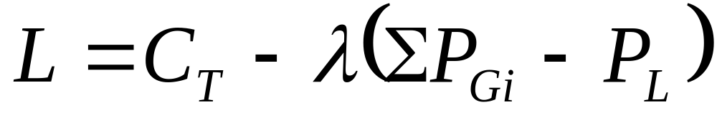
Economic Dispatch & the Lagrangean
min C_{T} = ΣC_{i}(P_{Gi})
s.t. Σ(P_{Gi}) = P_{L}
P_{Gi min} <= P_{Gi} <= P_{Gi max}
Then L = ?

Slide 26
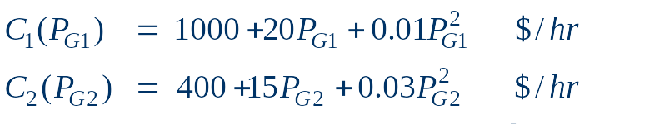
Economic Dispatch Example
What is the economic dispatch for the two generator problem with
  P_{G1} + P_{G2} = P_{D} = 500MW

Slide 27
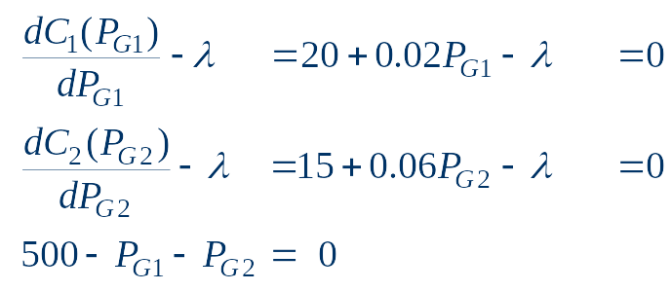
Economic Dispatch Example
Formulate the Lagrangean
Take derivatives
Solve

Slide 28
Economic Dispatch Example, cont’d

Slide 29
Economic Dispatch: Formulation
We find that
  P_{G1} = 312.5MW;
  P_{G2} = 187.5MW
λ = $26.2/MWh

Slide 30
Discussion
Key results for Economic Dispatch?
  Incremental cost of all generating units is equal
  This incremental cost is the Lagrangean multiplier, λ
  ‘λ’ is called the ‘System λ’ and is the system-wide cost of generating electricity
    This is the price charged to customers

Slide 31
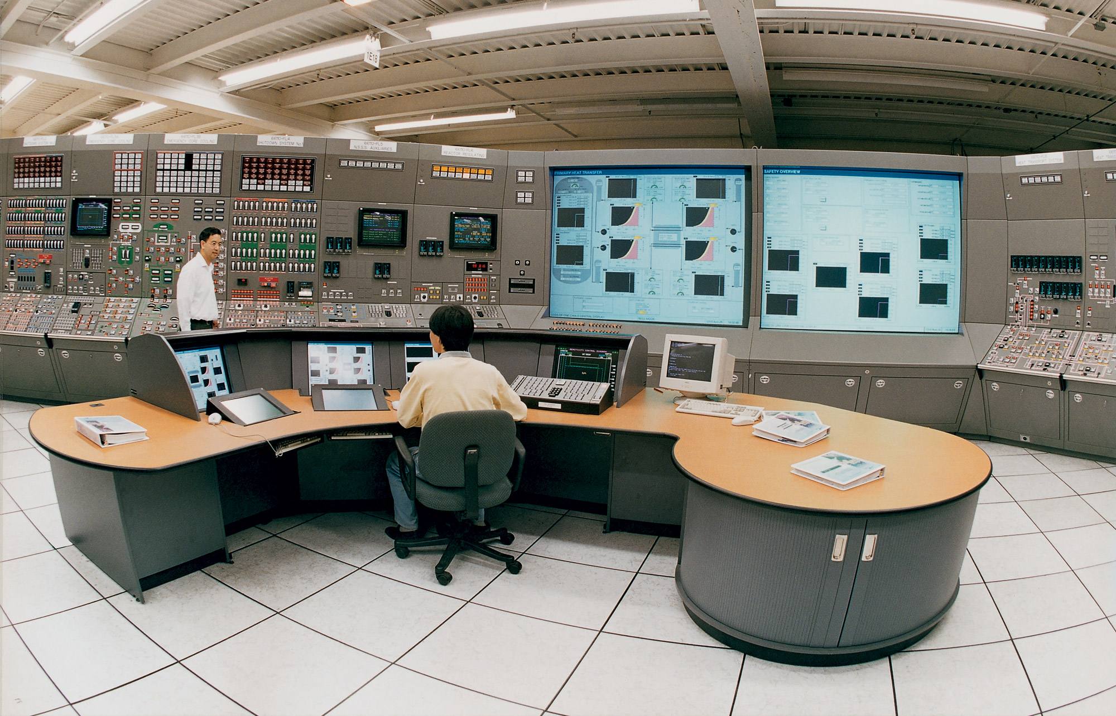
Power System Control Center

Slide 32

Power System Control Center

Slide 33

New England Power Grid Operator

Slide 34
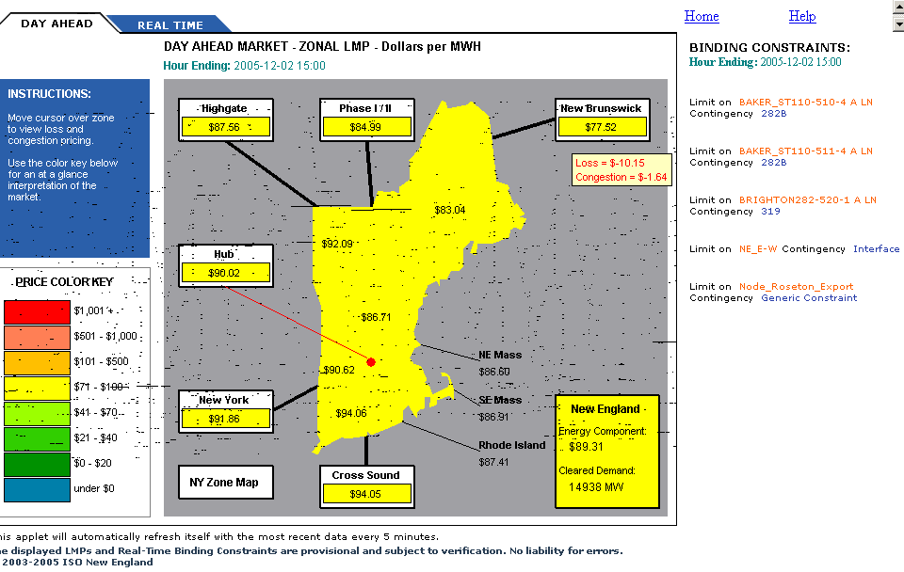
Regional Prices and Constraints

Slide 35



The Hong Kong Trade Development Council

Slide 36
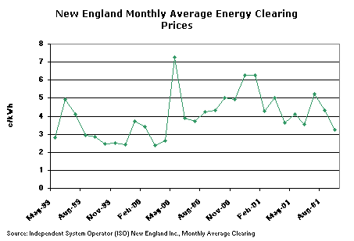
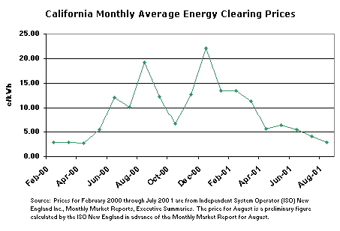

Slide 37
Summary
Economic dispatch is used to determine the least cost means of using existing generating plants to meet electric demand
To calculate the economic dispatch for a power system, the techniques of linear programming + the Lagrangean are used
Now to a review of the production cost homework results...

